Slide 1

FidMark: A Fiducial Marker Ontology For Semantically Describing Visual Markers
Maxim Van de Wynckel, Isaac Valadez, Beat Signer
Notes:
Hello, my name is Maxim Van de Wynckel; I am a PhD candidate at the Vrije Universiteit Brussel and today I will be presenting our Fidmark ontology; which is a fiducial marker ontology for semantically describing visual markers

Slide 2
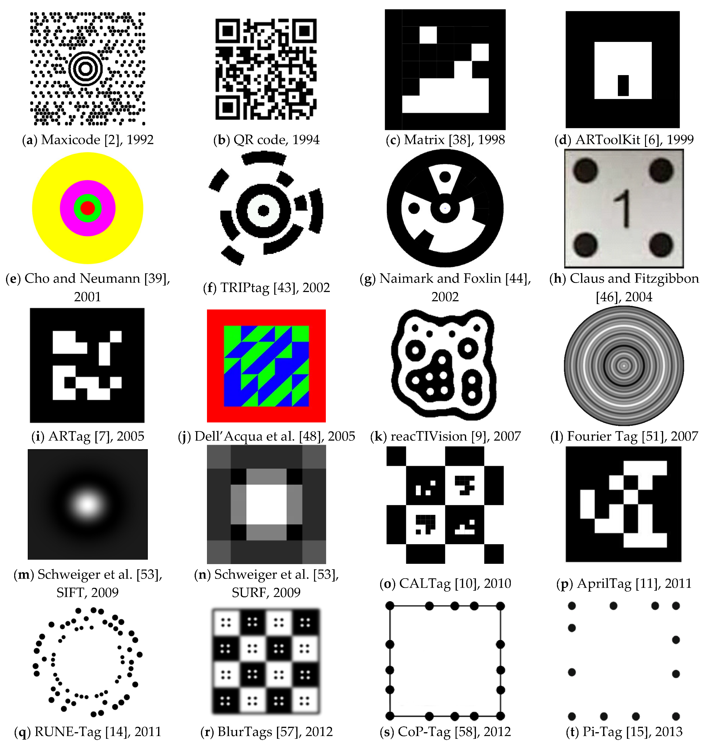
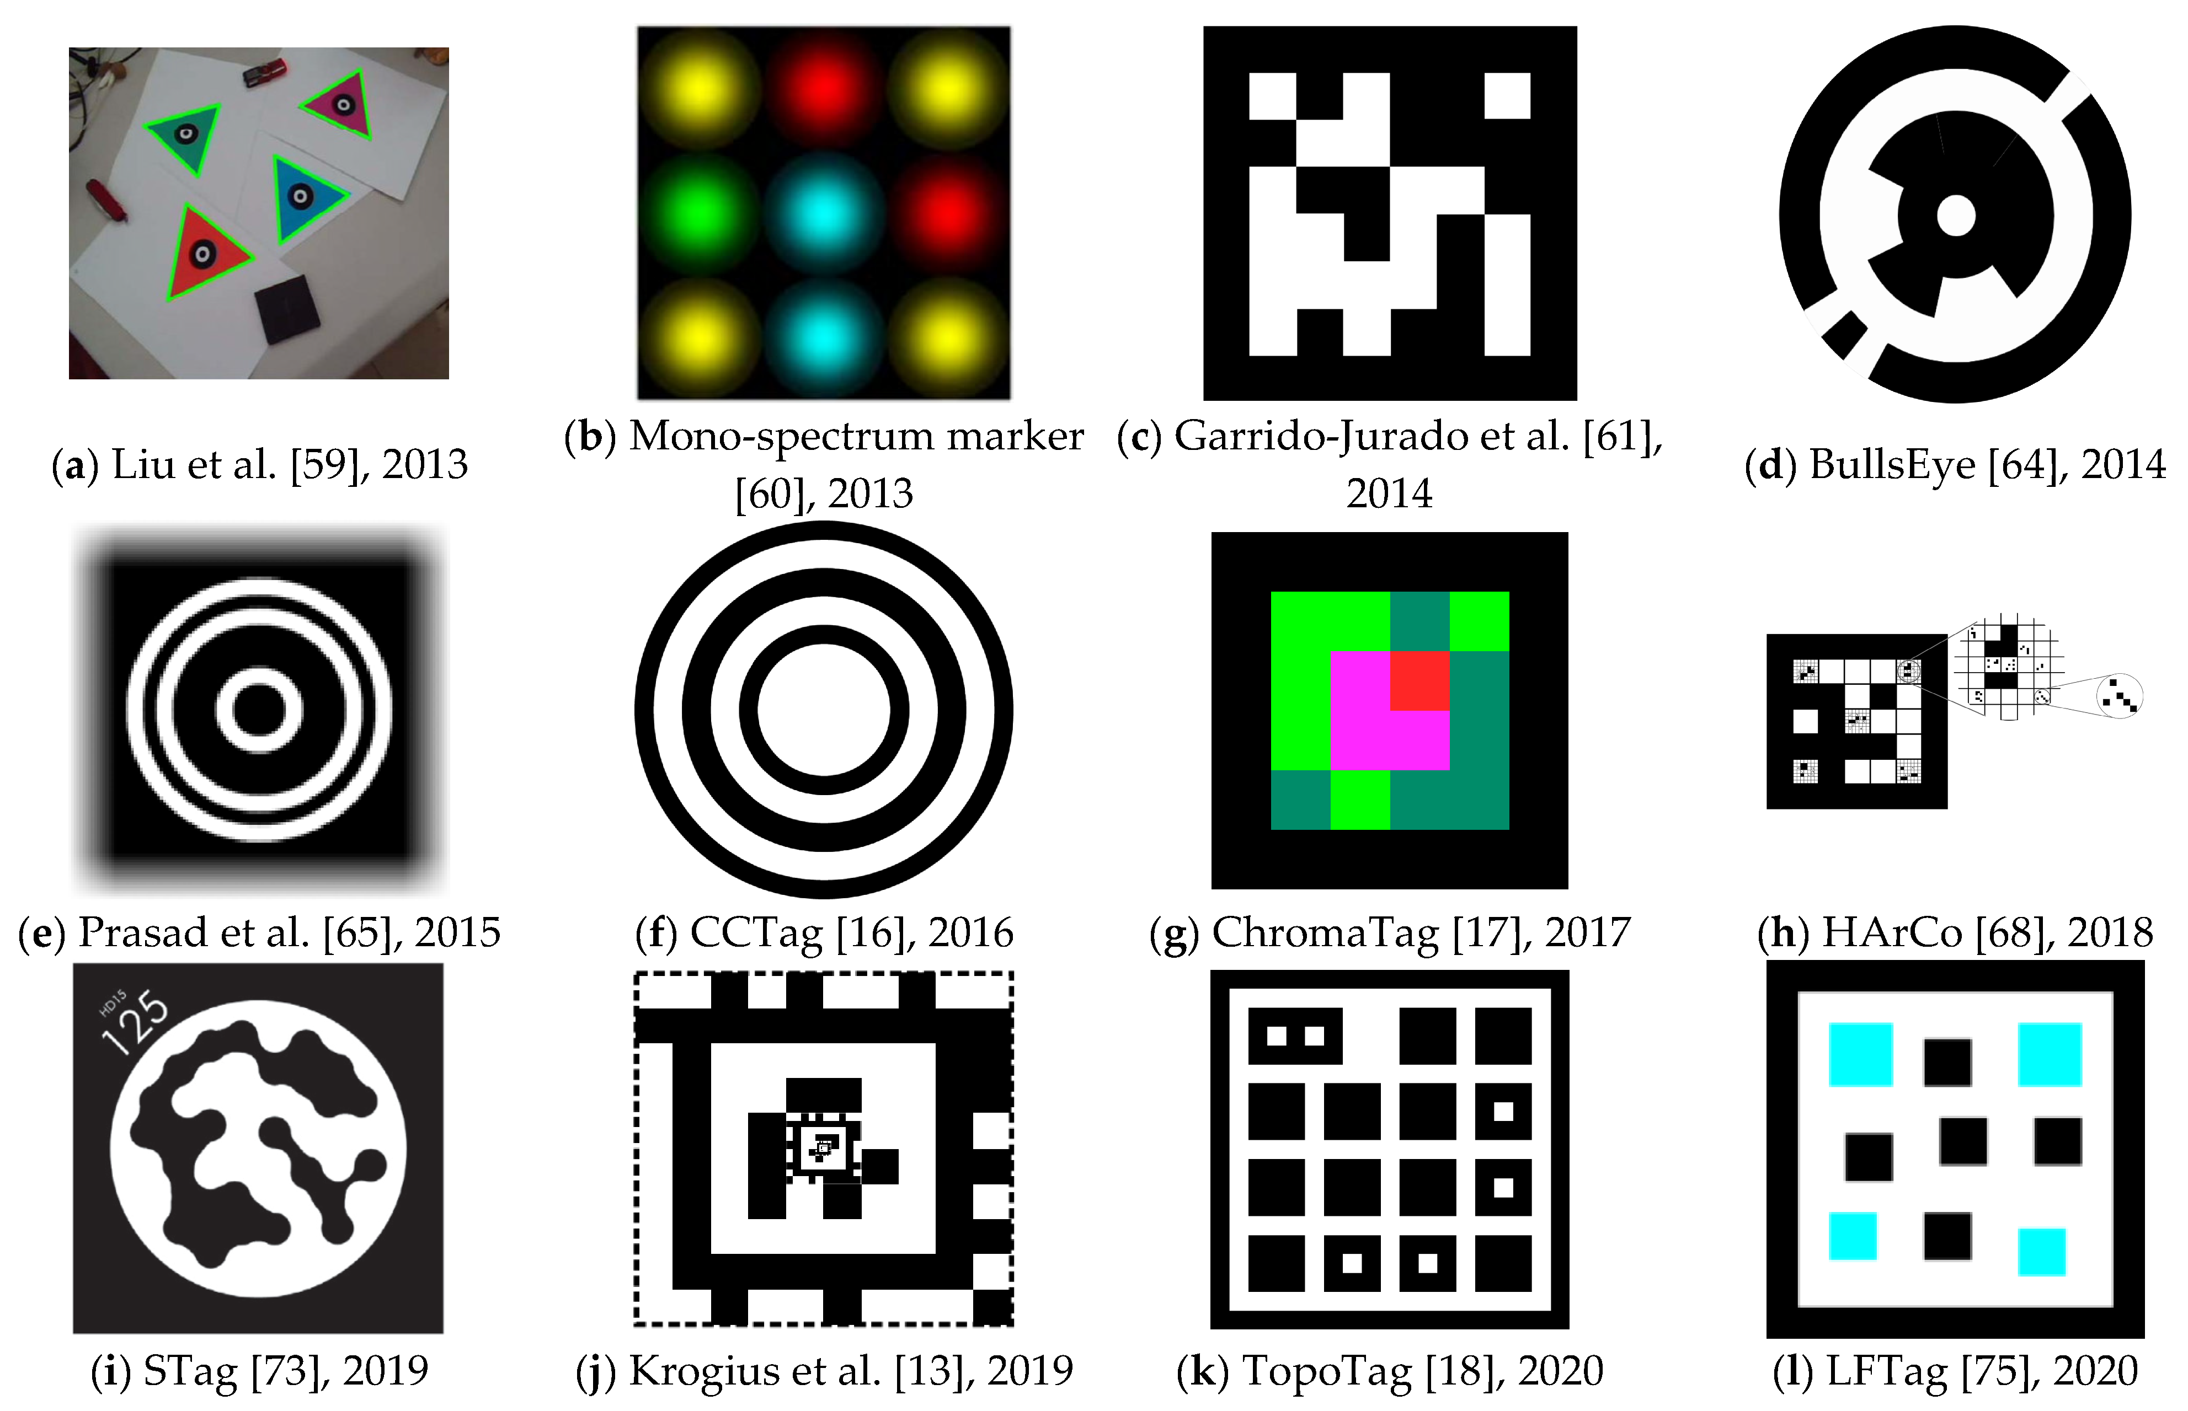
Background – Fiducial Marker
Košťák, M.; Slabý, A. Designing a Simple Fiducial Marker for Localization in Spatial Scenes Using Neural Networks. Sensors 2021, 21, 5407.
Notes:
To start off with some background, a fiducial marker is visual marker or set of features that can be detected
by a computer vision algorithm. When these fiducial markers have a known dimension, they can be used
as landmarks or anchors to position objects relative to these markers.
For augmented reality use cases, there are a large number of different fiducial markers, each with their pros and cons in different environmental conditions. In augmented reality these
markers find its use to perform pose estimation, which allows us to position virtual objects relative to these markers in three dimensions. Pose estimation also enables us to position ourselves, or more specifically the camera relative to one of these markers; which other that placing virtual objects relative to these markers also enables us to use them to determine our position.
The main issue with fiducial markers is that you need to know of their existence before being able to detect them, which requires a knowledgebase where we can learn this information.
Since there are no standardisations of what markers to use, this becomes challenging when wanting to develop interoperable AR application that can work together on the same data; or in this case the same AR environment.

Slide 3
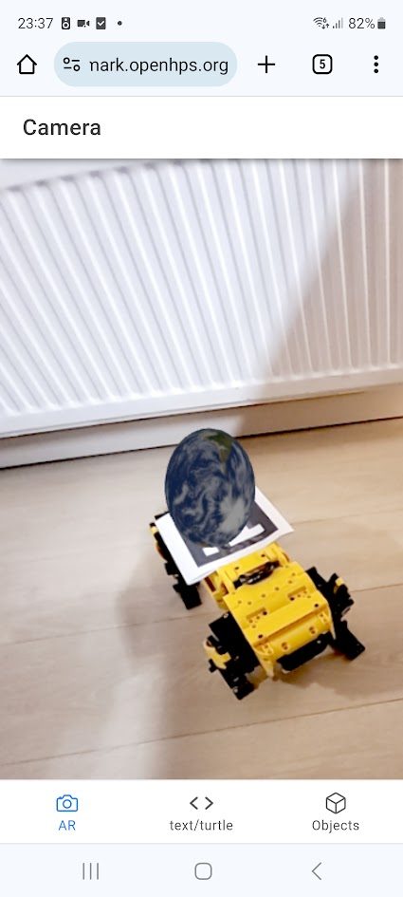
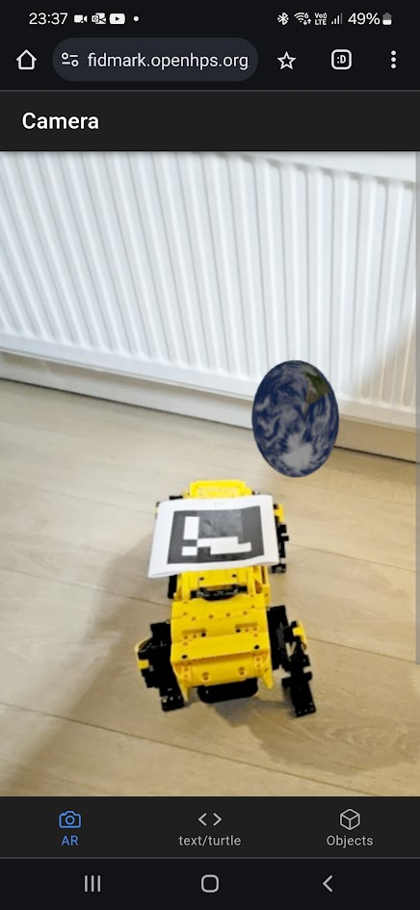
Problem
”How can we pave the way towards interoperable AR applications?”
How can we define a common reference frame between two independent augmented reality frameworks?
How can we define this common reference frame using a wide range of fiducial markers?
Notes:
The creation of interoperable AR applications has many different challenges, but one of the key challenges
is that there needs to be a common frame of reference between multiple applications, AR devices and users.
With FidMark, the goal is to solve this common reference frame for use cases which make use of fiducial markers.

Slide 4
Methodology
Identification of existing ontologies
Identification of existing frameworks
Identification of common markers types (and variations)
Design goals based on problem statement
Design of ontology
Validation of the design goals using SPARQL queries
Integration testing of the ontology
Based on the Linked Open Terms (LOT) methodology
Notes:
Out methodology approach consistsed of first identifying if any existing ontologies would enable us to describe fiducial markers in some extent.
There are vocabularies that contain terminologies like barcodes and even basic descriptors for fiducial markers used in medical sciences. But none of the ontologies we have found sufficed to describe a wide range of fiducial markers that could bring us closer towards interoperability of ar applications.
We continued with the identification of frameworks such as OpenCV or specialized frameworks designed to detect fiducial markers of academic research and used the terminologies within these frameworks to decide on the terminologies within our ontology. We also investigated the commonly used marker types along with their properties.
Next, and probably the most important, we created a set of design goals that we will discuss in a moment, which
Helped us scope the fidmark ontology to AR applications.
We eventually continued with the design of the ontology and validated the ontology using SPARQL queries for each of our design goals and a final integration test with a web-based demonstrator that we will showcase at the end of the presentation.

Slide 5
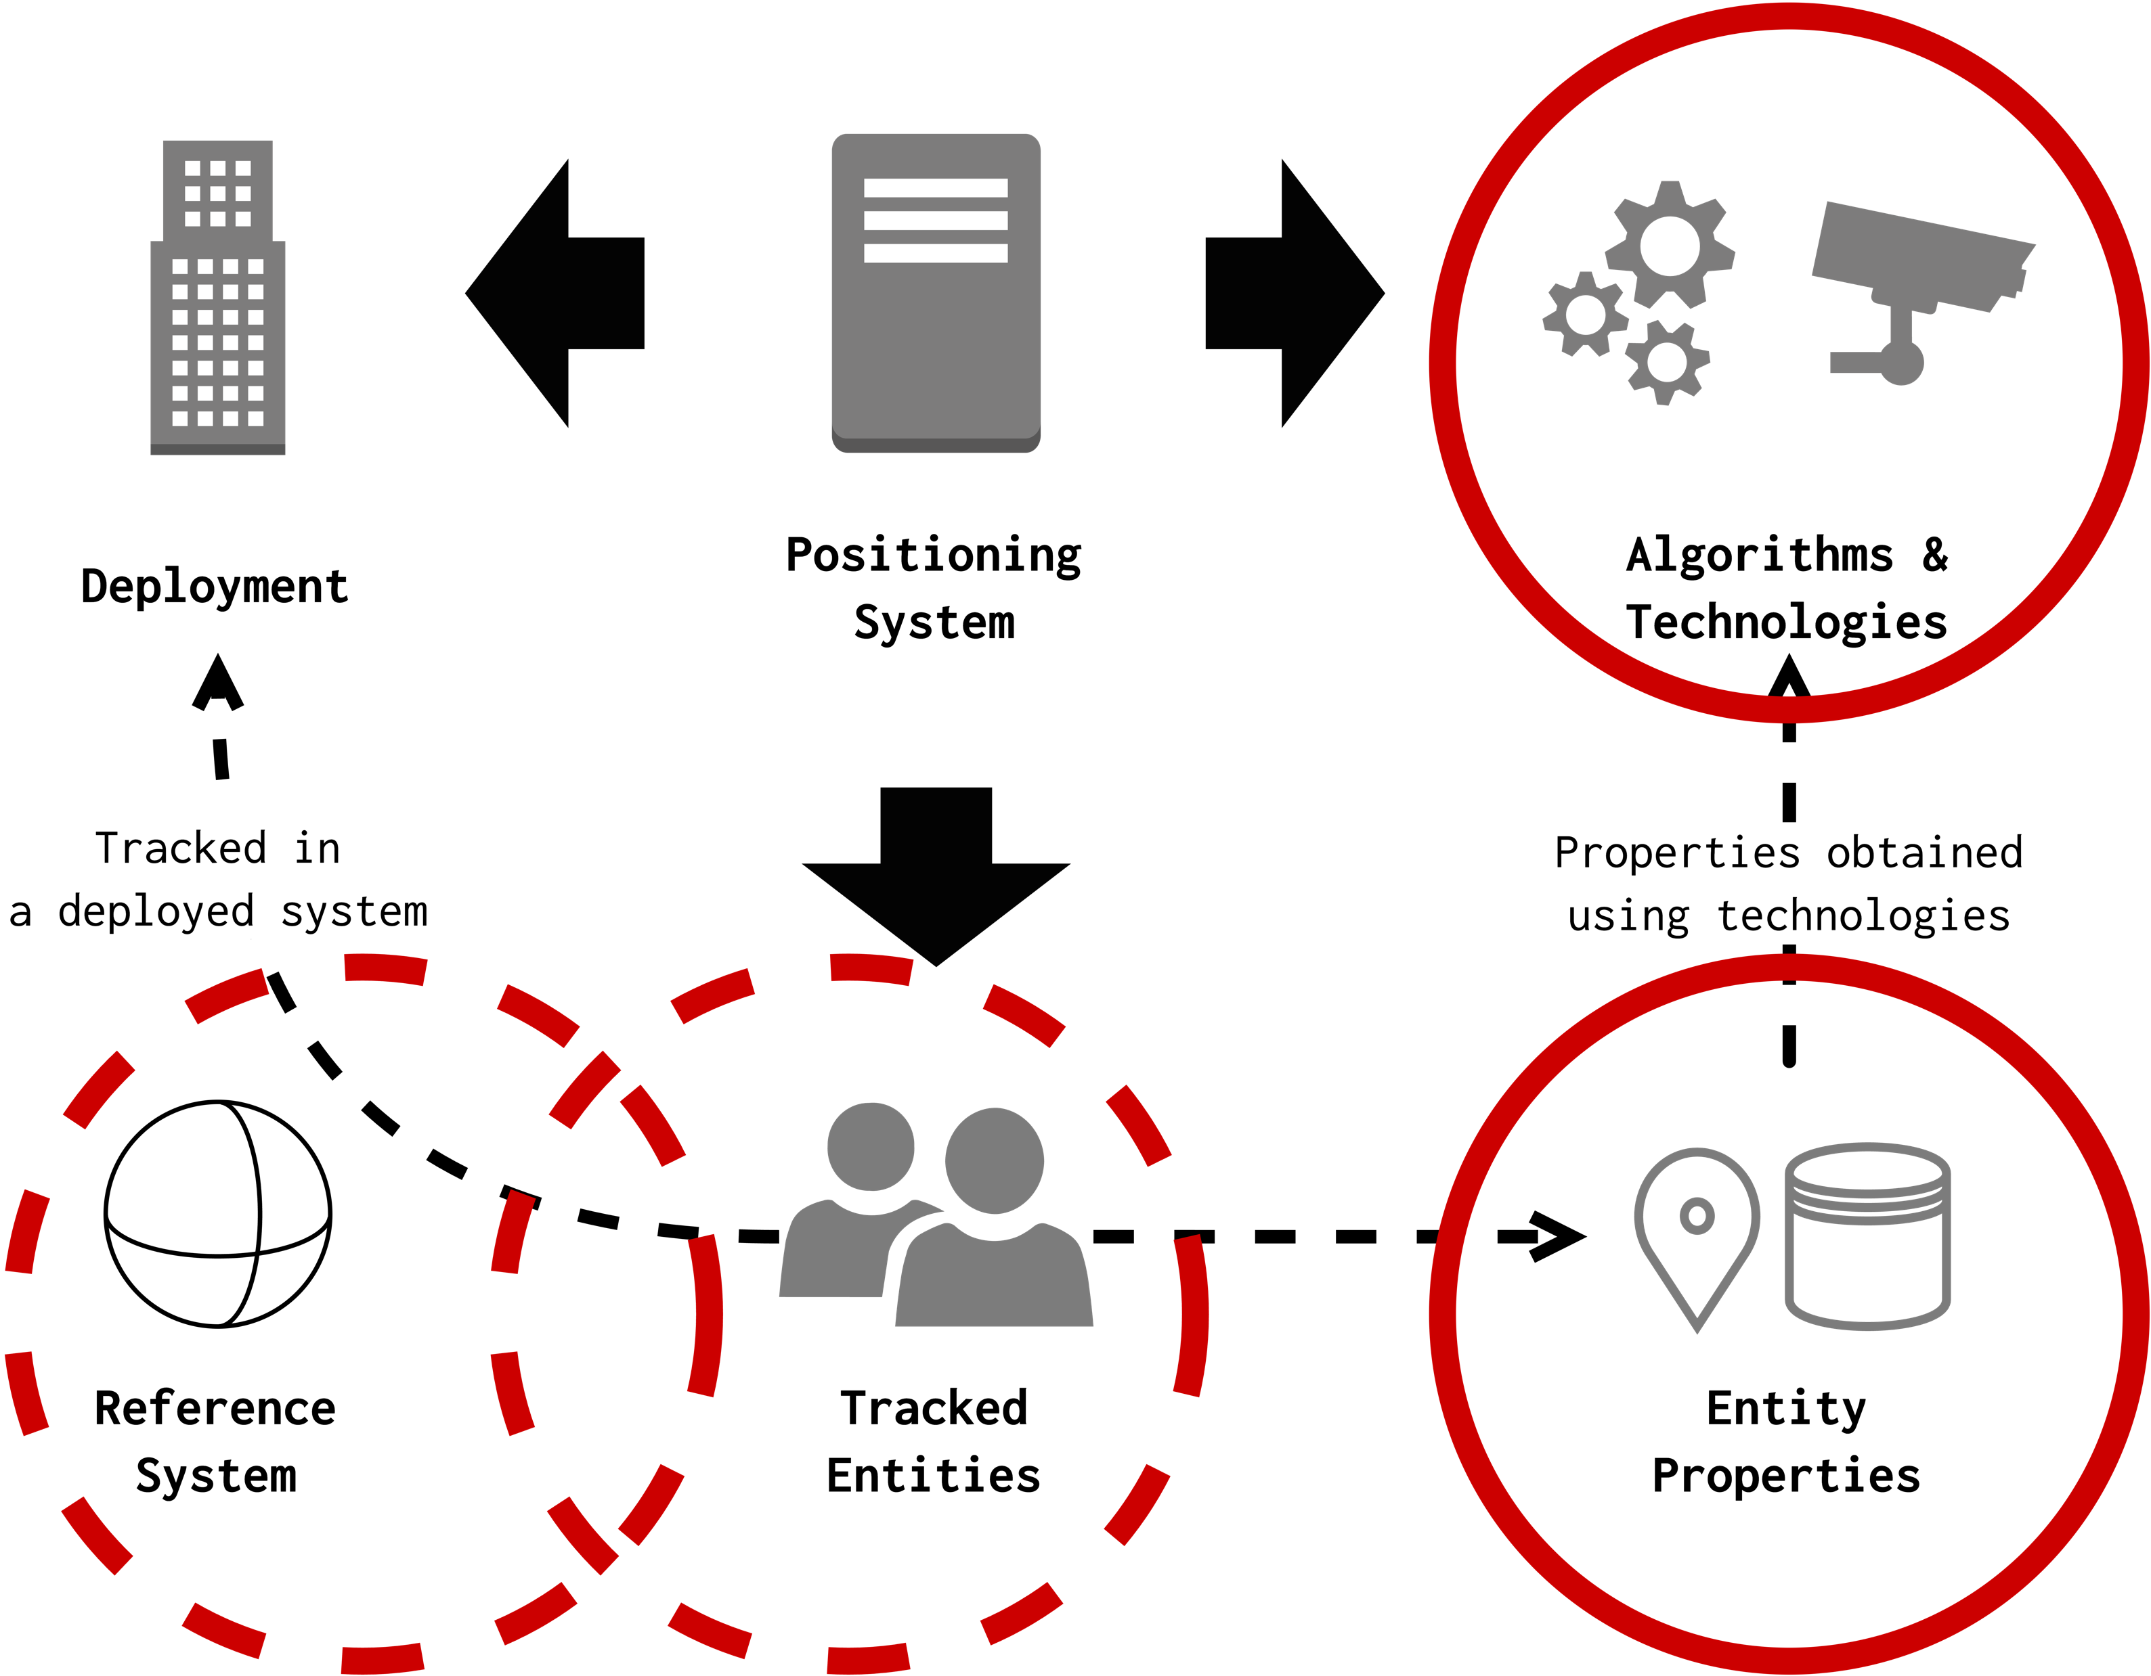
Ontology Design
Maxim Van de Wynckel and Beat Signer. 2022. POSO: A Generic Positioning System Ontology. In The Semantic Web – ISWC 2022: 21st International Semantic Web Conference, Virtual Event, October 23–27, 2022, Proceedings. Springer-Verlag, Berlin, Heidelberg, 231–247.
Notes:
Our ontology is built on top of POSO, which a generic Positioning System Ontology introduced at ISWC 2022.
POSO on itself is built on top of Systems observations Sensors and Actuators ontology.
POSO already handles the positioning of objects and the description of “positioning techniques” as procedures that are performed on data.
Fidmark uses POSO as a core ontology to describe different markers, their dictionaries and identification
Methods – as well as the common pose estimation techniques as the “ positioning techniques” of POSO.

Slide 6
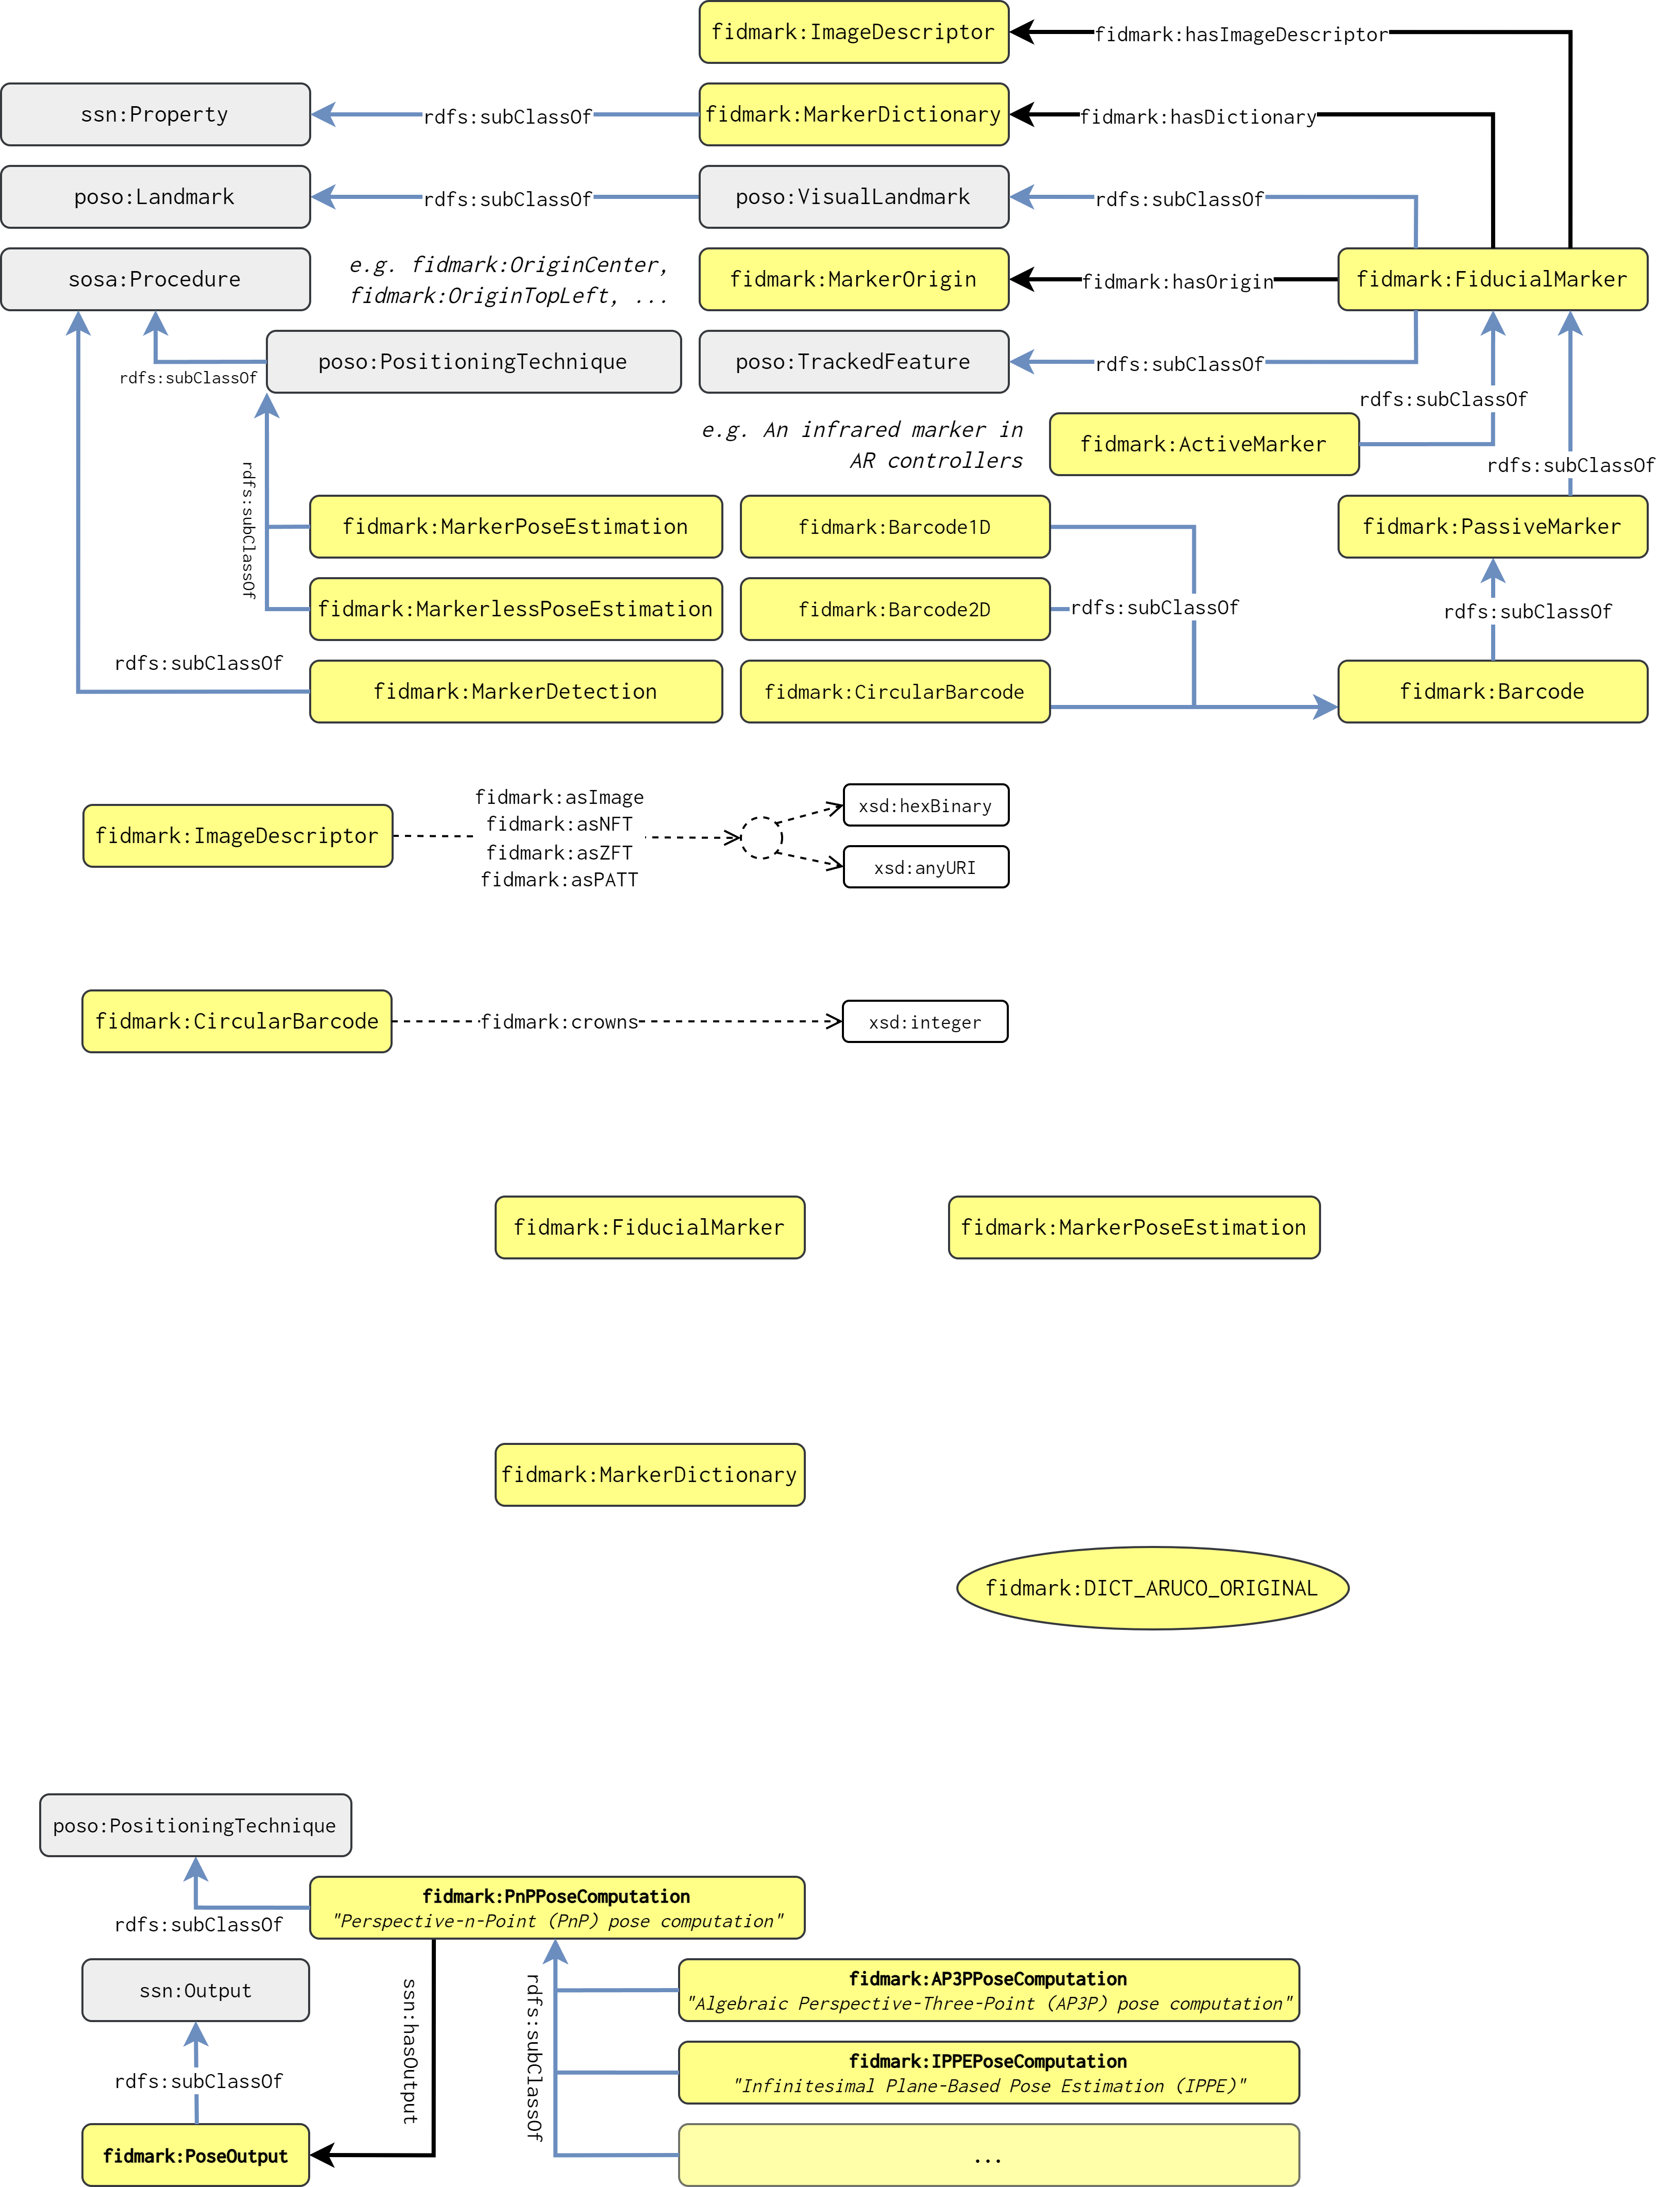
Ontology Design
Notes:
In the following image you can see the “main” classes of FidMark related to the description of markers in yellow.
The core ontologies, POSO, SSN and SOSA are depicted in gray.
POSO already defines two concepts; a Visual Landmark and tracked feature. A tracked feature is a feature of interest that
whose position can be determined by a system. A visual landmark is a landmark that has a known position. In our case, our fiducial markers are visual landmarks that we can determine a position of or use it to position objects relative to the markers.
We classify two types of fiducial markers; passive markers such as for example 2d barcodes such as aruco marker or circular barcode and active markers that actively communicate their data or identifier; such as infrared markers. Since these active markers are less common and more proprietary we did not provide subtypes for this type – but making the distinction between the two marker types enables us to strictly define active markers as markers that require a stream or feed of video data, while a passive marker could very well be a simple picture of a marker.
A fiducial marker can have a dictionary, center of origin and image descriptor. The latter is used for markers that are defined based on a trained image rather than a fixed dictionary or topology.
Finally, we extend the Positioning techniques of POSO and sosa procedures with pose estimation and also the simple detection of fiducial markers which should be performed before performing marker based pose estimation.

Slide 7
Ontology Design
Notes:
To illustrate the pose estimation a bit further; We have several subtypes ot perspective-n-point pose computation algorithms based on the algorithms that are available in the open source computer vision framework OpenCV.

Slide 8
Validation
OOPS! Validator (OntOlogy Pitfall Scanner)
Examples and generated dummy data
… random markers and virtual objects positioned relative to these markers
SPARQL queries to answer design goals
Demonstrator Web application
… and TypeScript library for implementing FidMark with js-aruco2, OpenHPS and Three.js
Notes:
With the aim to validate our ontology and more specifically our design goals, we have conducted several validation steps on top of our ontology.
We created dummy data with fiducial markers and virtual objects positioned relative to these markers. We used this dummy data to test several SPARQL queries that answer our individual design goals.
As an integration test we created a demonstrator web application that we will discuss in more detail later.

Slide 9
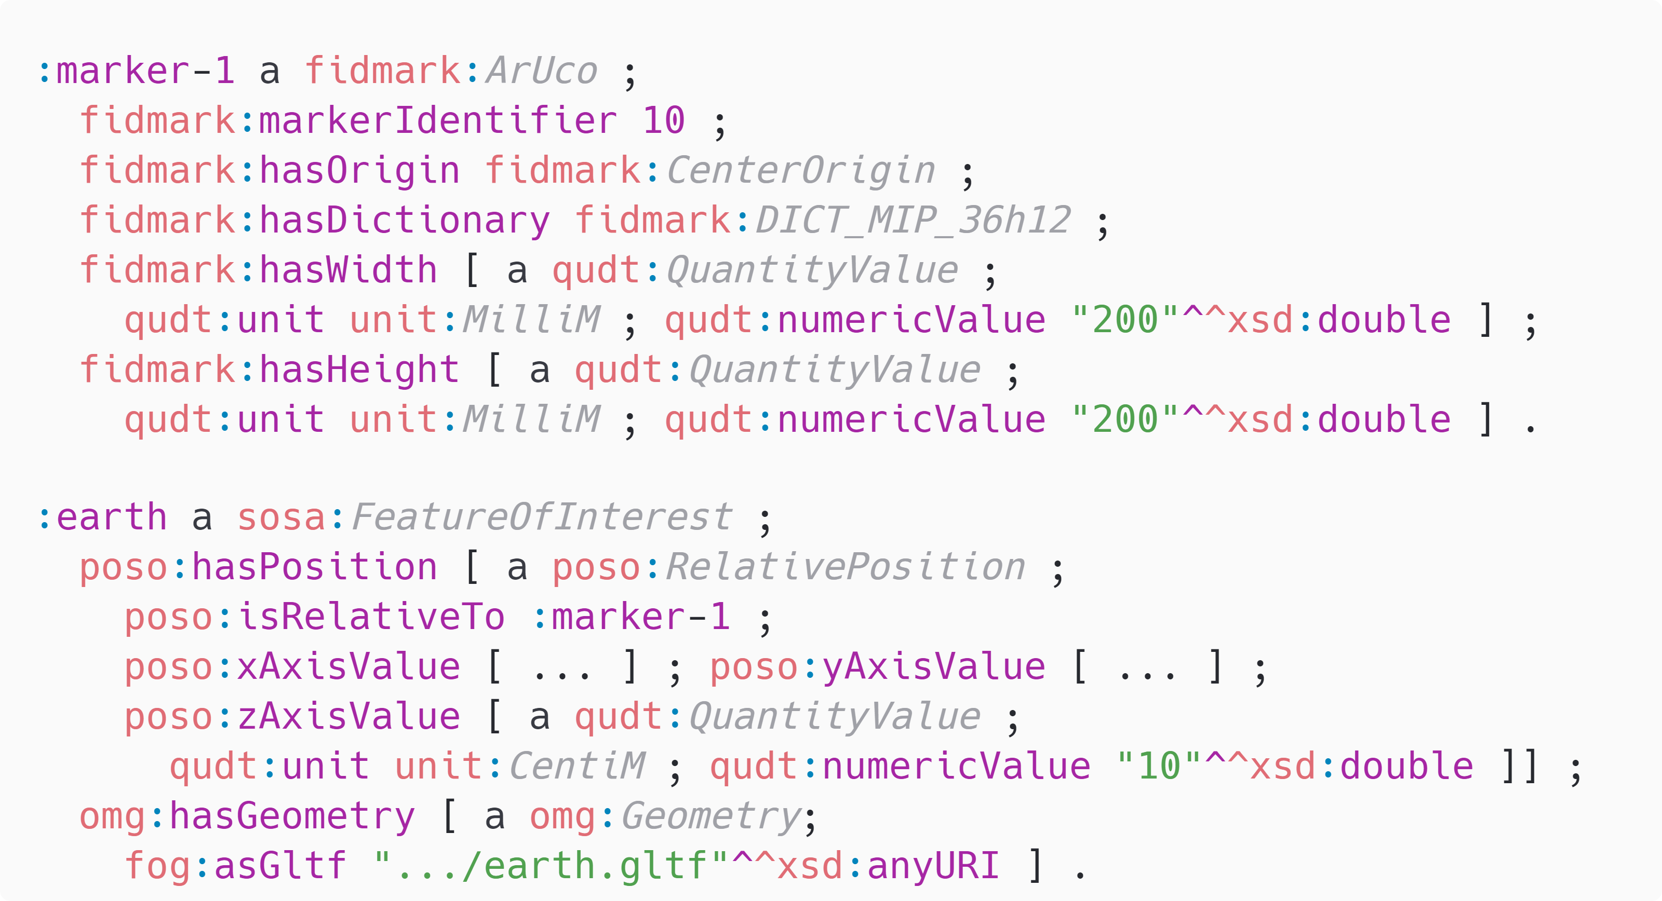
Validation – Example
Notes:
To provide an example of how our FidMark ontology can be used to describe objects we have
an ArUco marker with a dictionary and an indentifier.
We clarify that we intent the origin of the marker to be in the center of the maker and finally we indicate the width and height of the marker so the scale can be used to appropriately scale virtual objects positioned relate to this marker.
Next, we have an example of a virtual object of the planet Earth that is positioned 10cm above the marker.
Semantically, this means that the position of this virtual object is 10cm relative to the center of the marker with identifier 10.

Slide 10
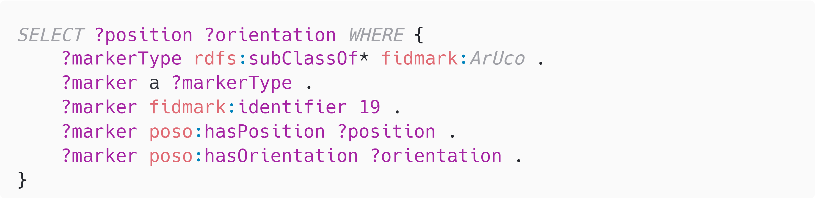
Validation – SPARQL queries
Get the position and orientation of a detected marker
(i.e. an ArUco marker with ID 19)
Notes:
Imagine if we have an AR application that detects an ArUco marker with identifier 19. We want to use the FidMark ontology to find contextual information about this marker, mainly its absolute position and orientation in our environment. A simple SPARQL query as shown here would enable us to find all instances of an ArUco marker or variations of an ArUco marker with identifier 19,
and get its position and orientation.

Slide 11
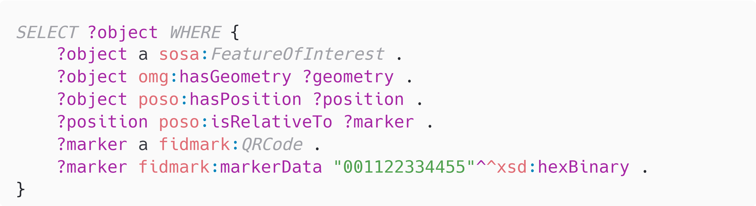
Validation – SPARQL queries
Get all virtual objects placed relative to a QR-code marker
with the data 0x001122334455
Notes:
Assuming we have an AR application that detects a QR code with certain data, we may want to investigate if this QR code is used in our AR application to perform relative positioning.
In such a scenario we could easily define the marker and query any object placed relative to this marker

Slide 12
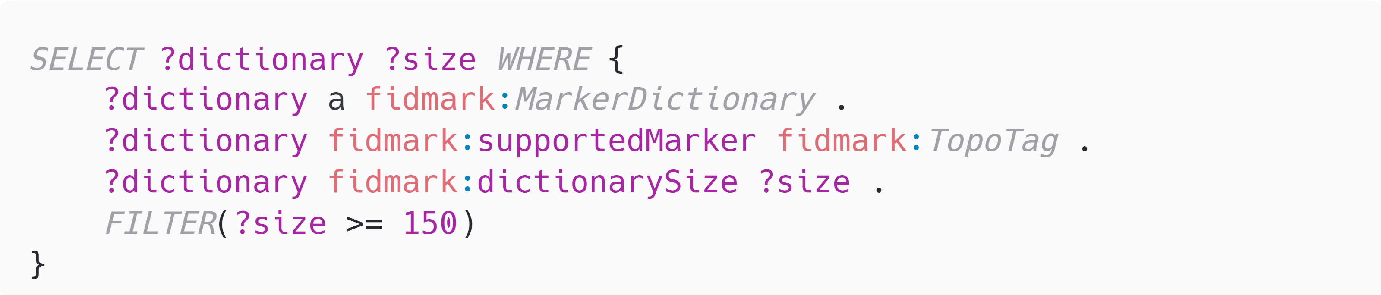
Validation – SPARQL queries
Find all dictionaries and the count of markers that can be identified in this dictionary for the marker type “TopoTag”. Ensure that at least 150 markers can be identified.
Notes:
Our ontology can also be used as a knowledgebase to determine which type of marker to use. Let’s assume we want to use a TopoTag to describe an environment. We know we need at least 150
markers to cover all areas in our building. We can use a query as shown here to determine which existing or known dictionary can be used for TopoTag.

Slide 13
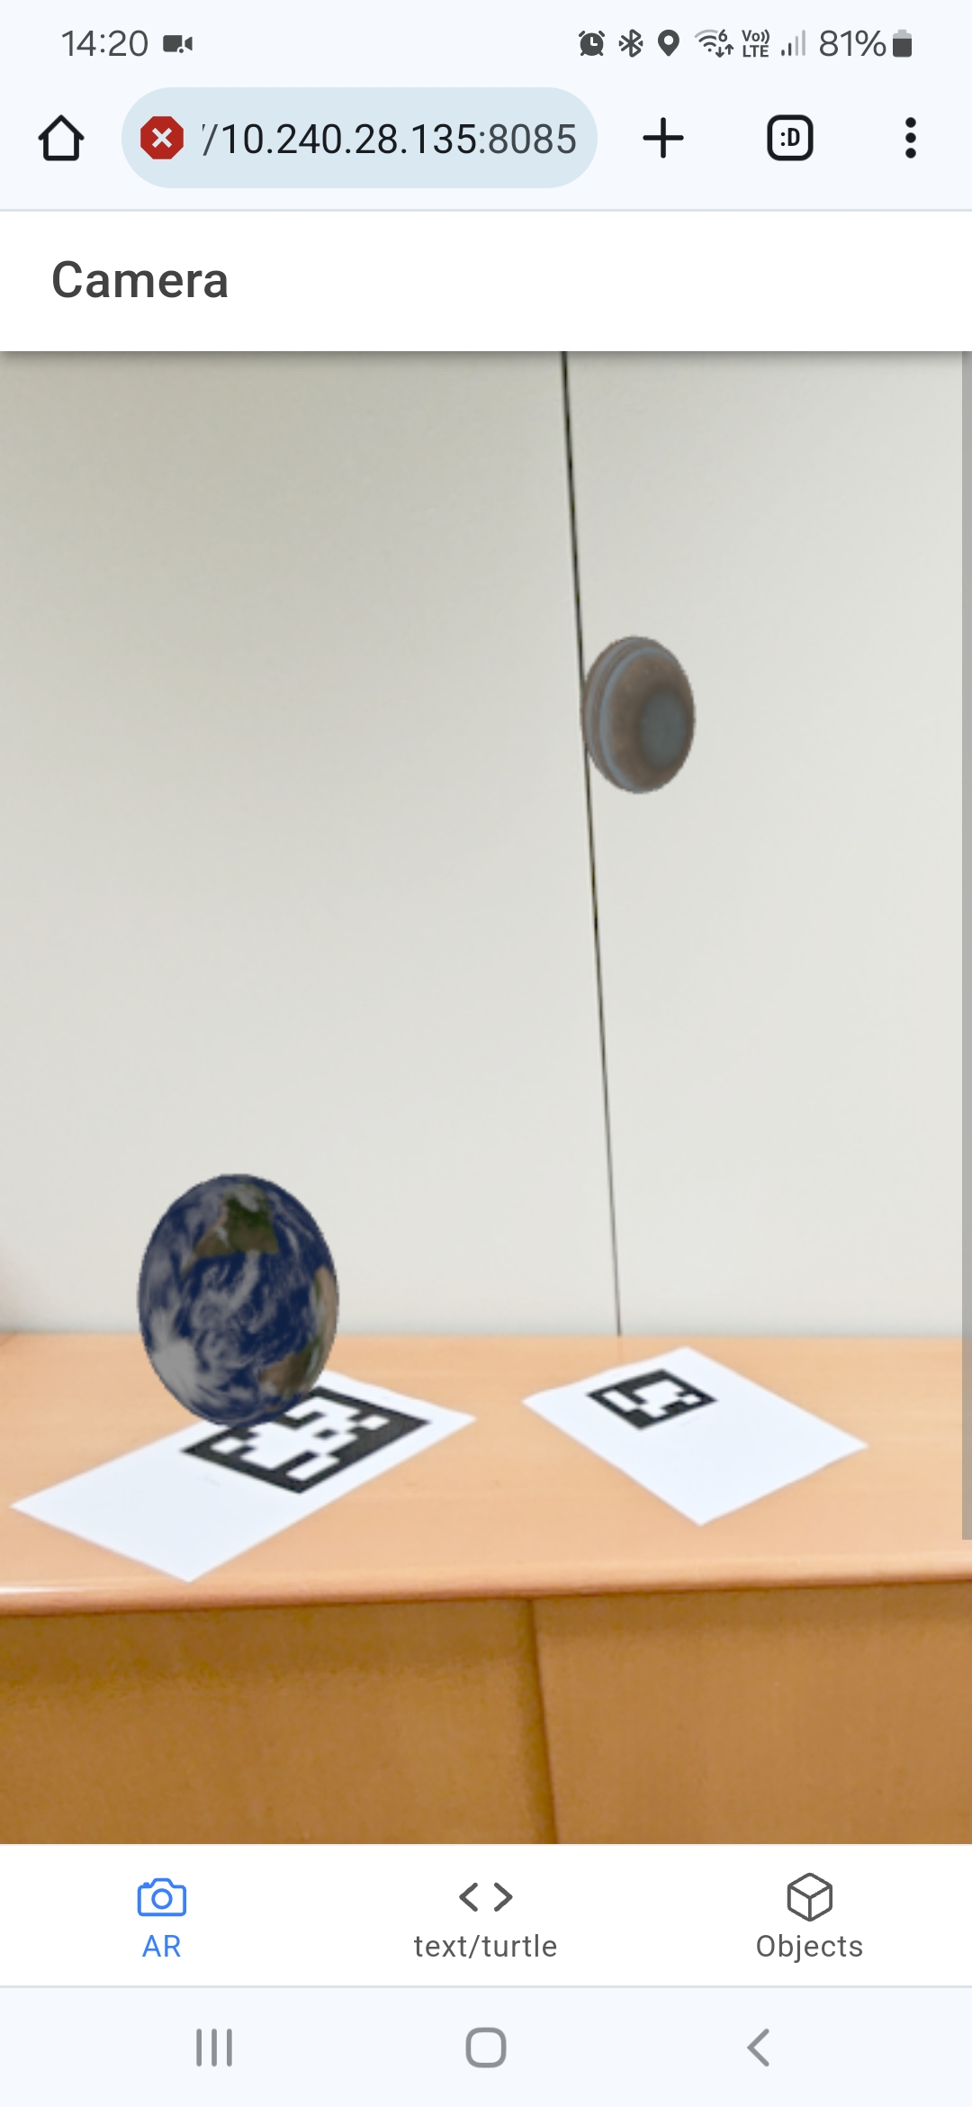
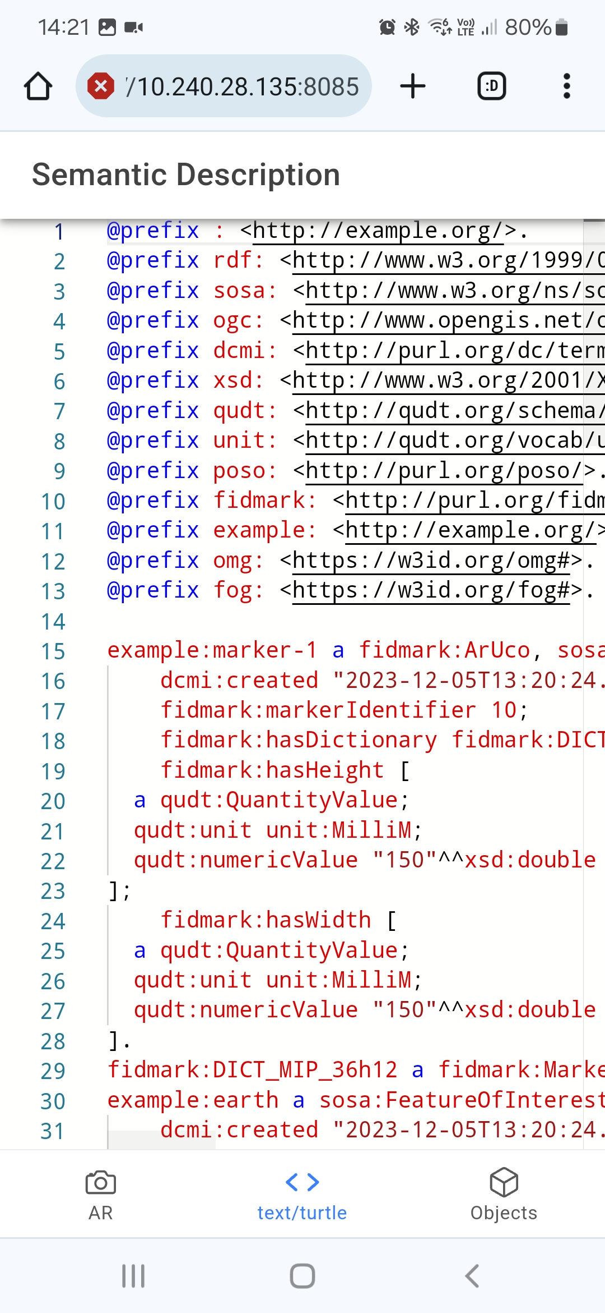
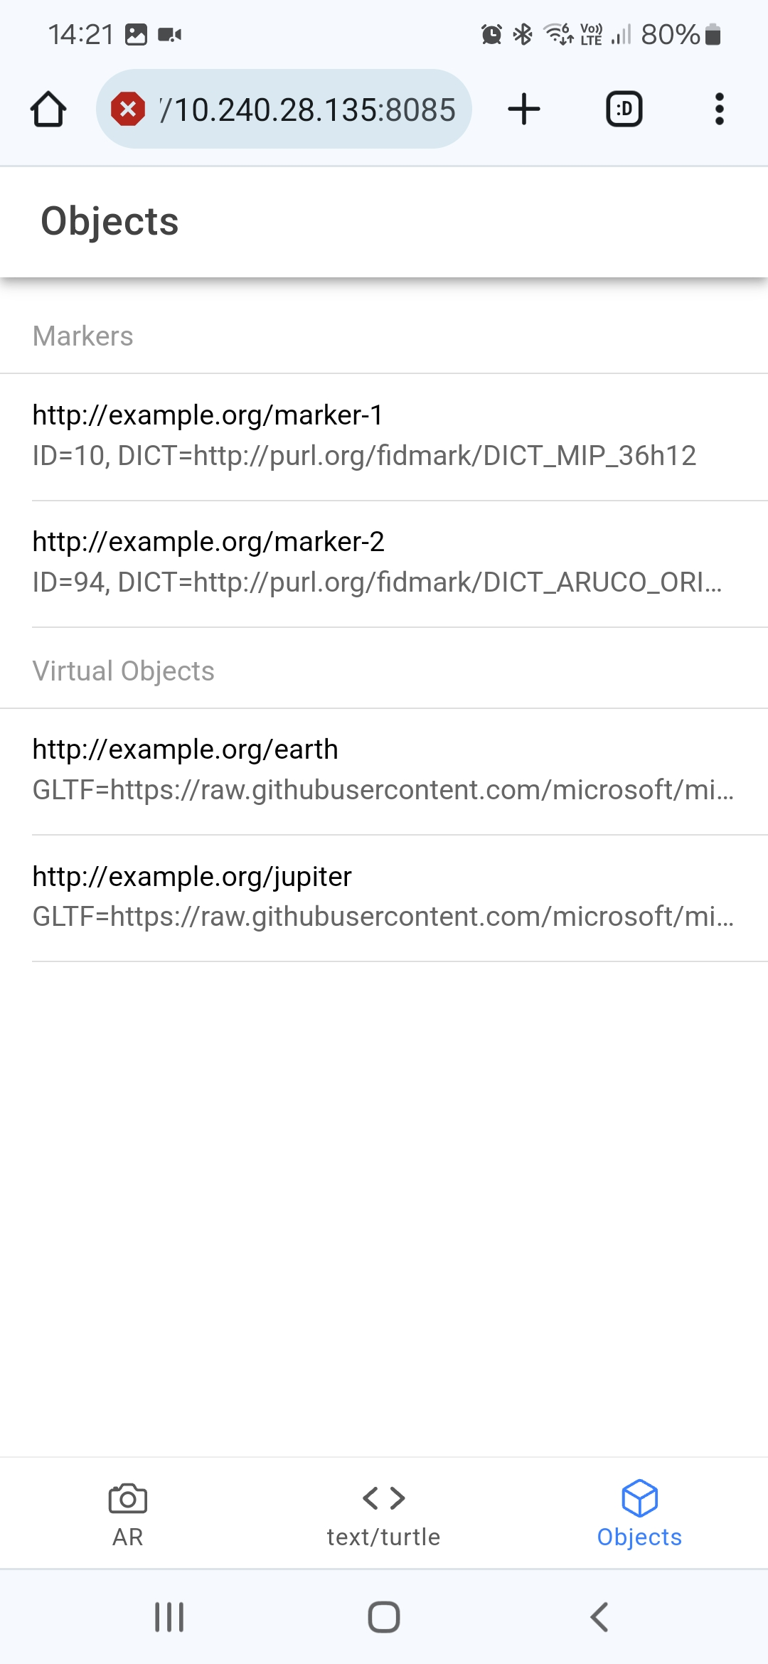
Demonstrator
Notes:
The demonstrator we have developed as part of this ontology is to demonstrate a basic example in which a marker can and should be described for it to be used in an augmented reality application.
This demonstrator is available online and simply showcases the RDF description of a marker and virtual objects positioned ‘relative’ to this marker. Editing the RDF description such as changing the relative
position, changing the marker type or identifier will result in the AR view changing.
You can also add additional virtual objects to the scene or new markers by adding RDF data.
Currently there is no collaboration between different frameworks or applications, but what we want to demonstrate with this demo is that we can establish a way to represent these markers and how we envision this ontology to be used within interoperable AR applications

Slide 14
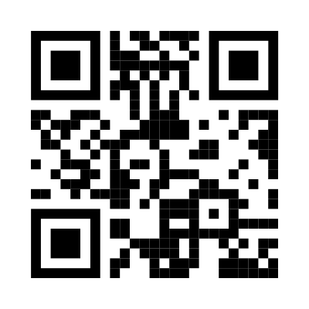


Conclusions and Future Work
Fiducial marker ontology with a focus on Augmented Reality and pose estimation
Extensible ontology with support for future marker types and dictionaries
Demonstrator application & TypeScript library
Future work will add new marker types and SHACL shapes
for each of these types
<maxim.van.de.wynckel@vub.be>
https://purl.org/fidmark/
https://fidmark.openhps.org/
https://github.com/OpenHPS/FidMark/
Notes:
To conclude, in this paper we presented our Fiducial Marker ontology. We focus on Augmented Reality applications
or other computer vision algorithms that perform pose estimation.
Our ontology is extensible with support for future marker types. We already ensured there is a clear division between different marker types. In addition markers can extend ea

Slide 15
FidMark: A Fiducial Marker Ontology For Semantically Describing Visual Markers
Maxim Van de Wynckel, Isaac Valadez, Beat Signer
Notes:
Hello, my name is Maxim Van de Wynckel; I am a PhD candidate at the Vrije Universiteit Brussel and today I will be presenting our Fidmark ontology; which is a fiducial marker ontology for semantically describing visual markers

Slide 16
Methodology - Design Goals
Central goal: “Interoperable Augmented Reality Applications”
DG1 Retrieve a list of supported markers
DG2 Retrieve markers using the identifiable information
DG3 Describe markers with a non-standard symbology
DG4 Enable pose estimation of markers
DG5 Enable relative positioning of objects to markers
DG6 Enable markers as engineering reference frames
DG7 Facilitate the integration in computer vision frameworks
Notes:
We came up with 7 design goals that we wish to accomplish with the final design. Each goal stems from the central goal of trying to create
Interoperable augmented reality applications that can work together with & relative to the same fiducial markers.
In order to accomplish this central goal; we should be able to use our ontology to retrieve a list of supported markers. A lot of the fiducial markers that exist are variants on one and the other. Our AR application should be able to get an overview of all commonly used markers so AR applications
known which are supported by the computer vision algorithms within this application.
Our 2nd design goal is to be able to retrieve markers using identifiable information; which includes the type of marker; the identifier or encoded data of a marker if present and optionally a dictionary used to map the topology of the marker to an identifier.
As already mentioned in design goal 1, different marker types can have different variations depending on the dictionary or symbology that is used. FidMark should be scaleable enough to define your own dictionaries.
A general description of a dictionary is a way to encode the visual information in order to uniquely identify a range of
markers. Fiducial markers play around with these dictionaries to introduce error correction or visibility at larger distances.
Another thing we want to accomplish was the facilitation of pose estimation. Different frameworks handle markers in a different way. For example one pose estimation algorithm may put the center of origin in the center of the detected marker while another puts it at one of the corners. With our aim for interoperability, this should be clearly defined.
Design goal 5 and 6 are a bit similar. We want to enable relative positioning of objects to markers in some way; the ideal solution this case would be to treat the markers as their own reference frame but thi.
Finally, our last design goal slightly overlaps some of the previous design goals in a sense that we want to ensure the easy integration of fiducial markers in CV frameworks. Our ontology should be able to describe the fiducial markers in an unambiguous way while still allowing developers to select the appropriate algorithms that are available to them to detect these markers. In a way, this last design goal ensures that we do not forget for what use case we are designing this ontology for.

Slide 17
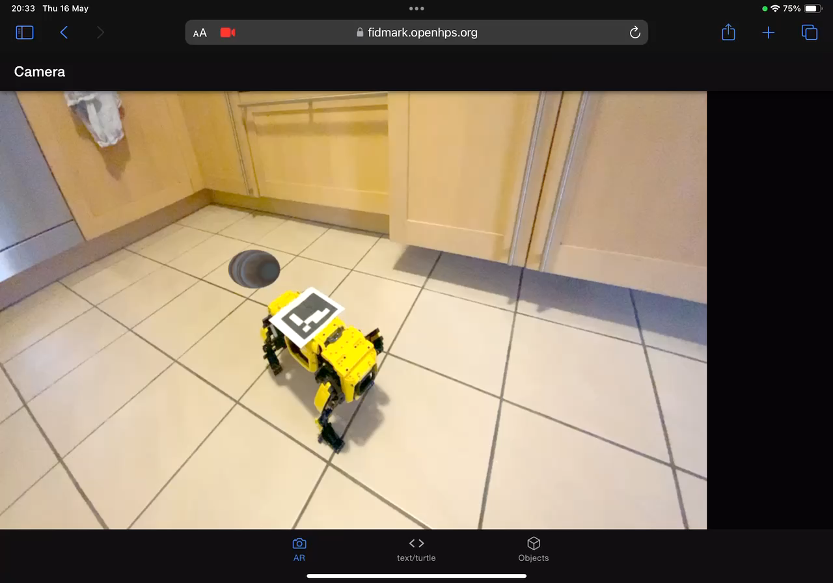
Demonstrator
Notes:
The demonstrator we have developed as part of this ontology is to demonstrate a basic example in which a marker can and should be described for it to be used in an augmented reality application.
This demonstrator is available online and simply showcases the RDF description of a marker and virtual objects positioned ‘relative’ to this marker. Editing the RDF description such as changing the relative
position, changing the marker type or identifier will result in the AR view changing.
You can also add additional virtual objects to the scene or new markers by adding RDF data.
Currently there is no collaboration between different frameworks or applications, but what we want to demonstrate with this demo is that we can establish a way to represent these markers and how we envision this ontology to be used within interoperable AR applications

Slide 18
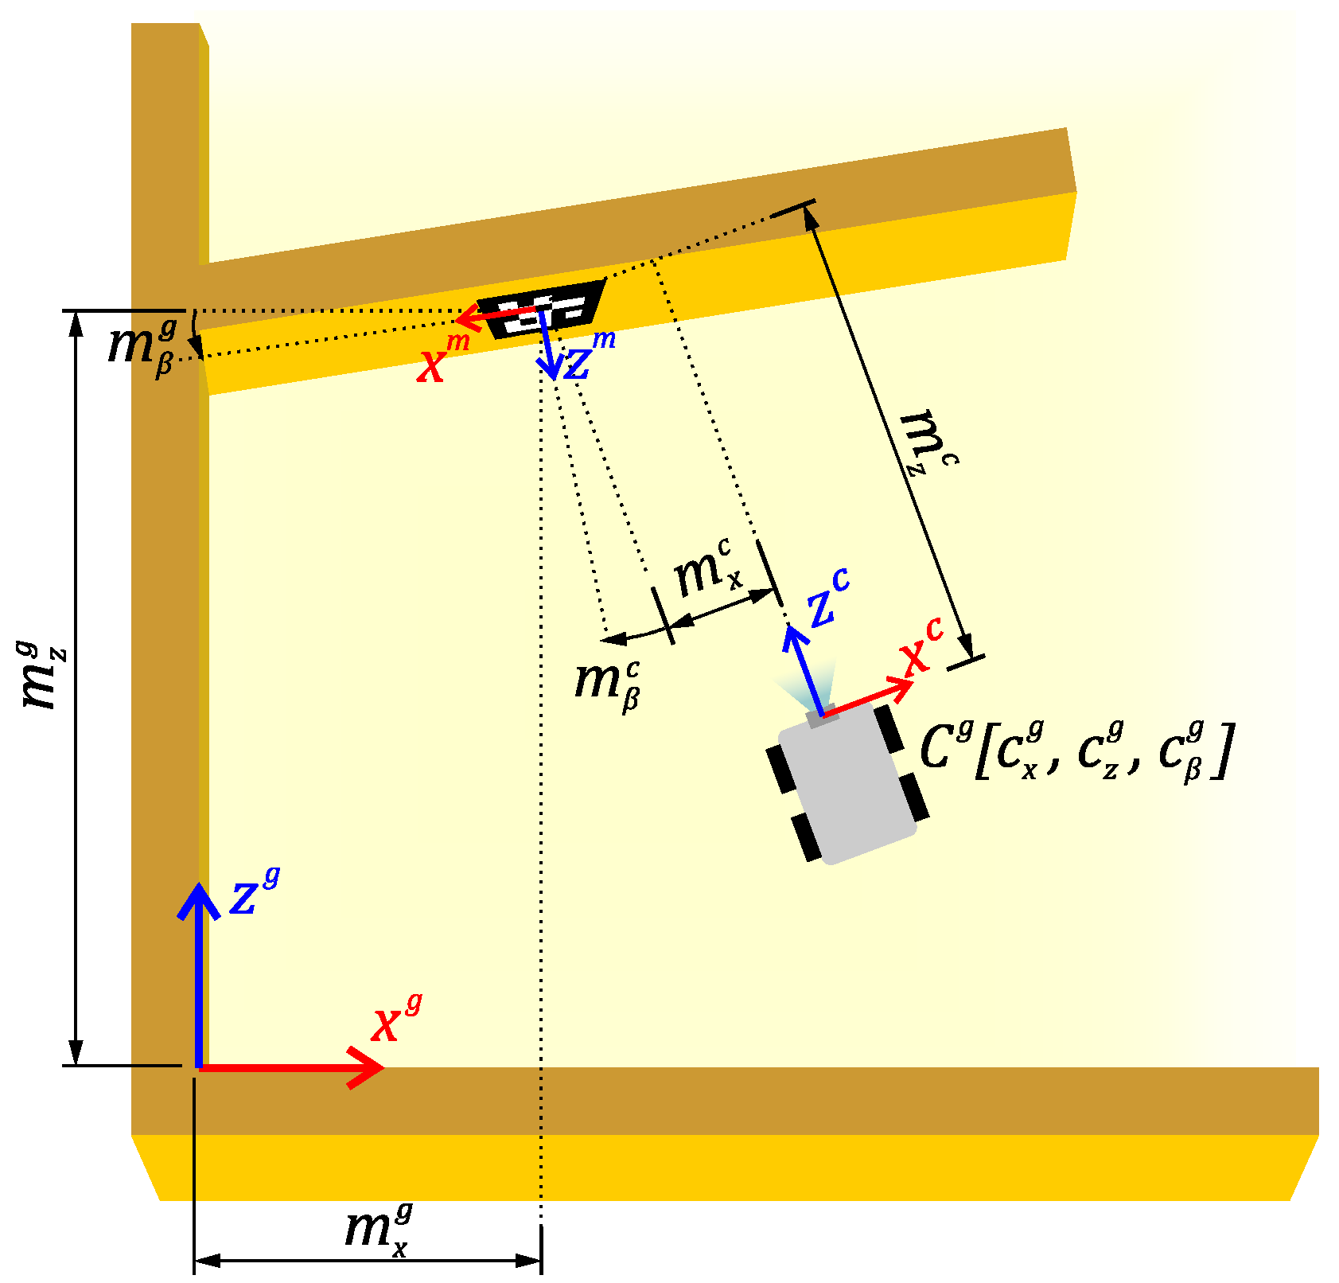
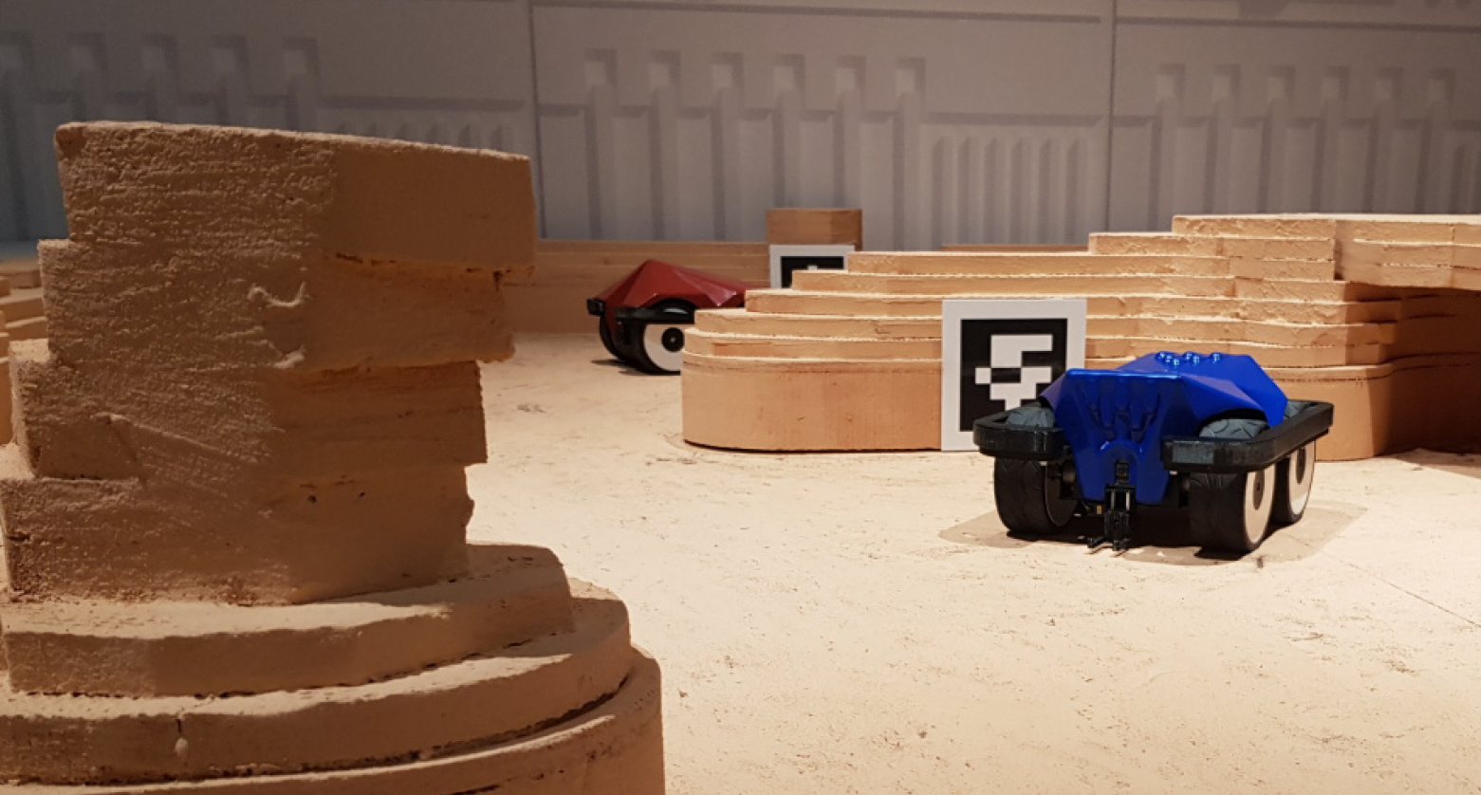
Background – Pose Estimation
Adámek R, Brablc M, Vávra P, Dobossy B, Formánek M, Radil F. Analytical Models for Pose Estimate Variance of Planar Fiducial Markers for Mobile Robot Localisation. Sensors. 2023; 23(12):5746.
Notes:
If we briefly delve a bit into pose estimation – we have a simple example of related work where a robot determines its position based on a marker with a known position within the environment.
However, it should be noted that the pose estimation can also be reversed with markers placed on a moveable object that is tracked by stationary cameras.

Slide 19
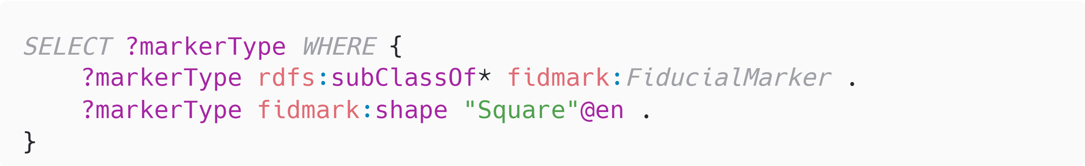
Validation – SPARQL queries
Select all square fiducial marker types

Slide 20
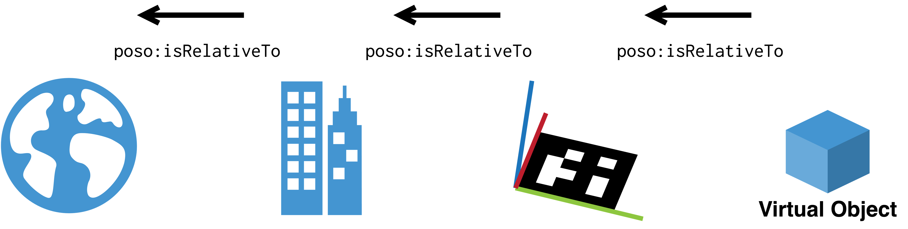
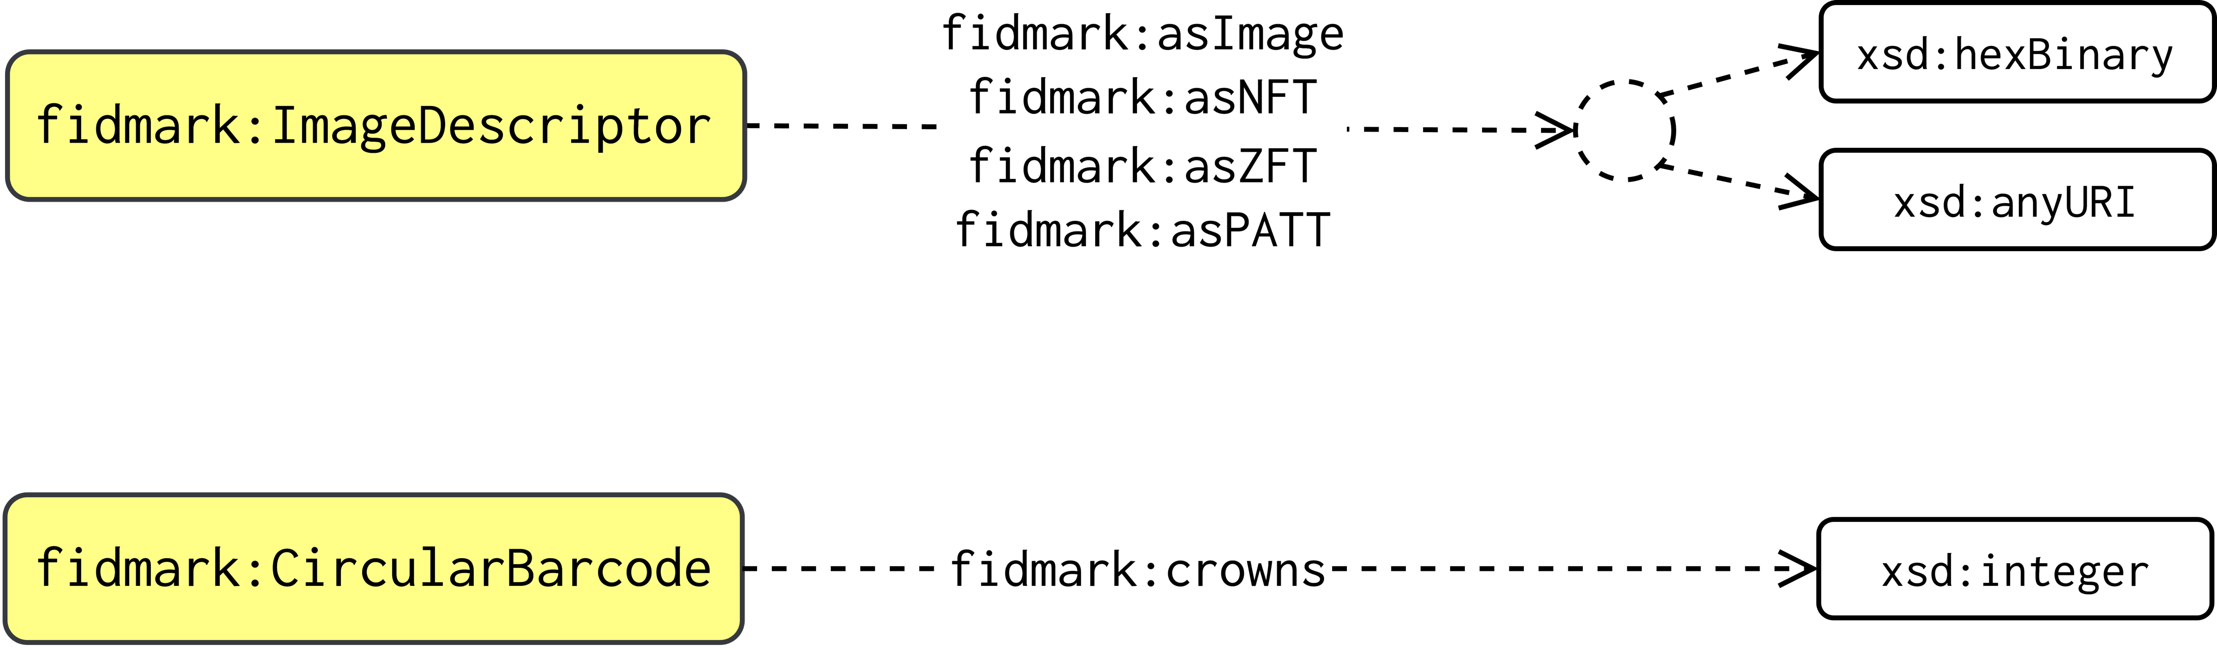
Supporting Slide

Slide 21
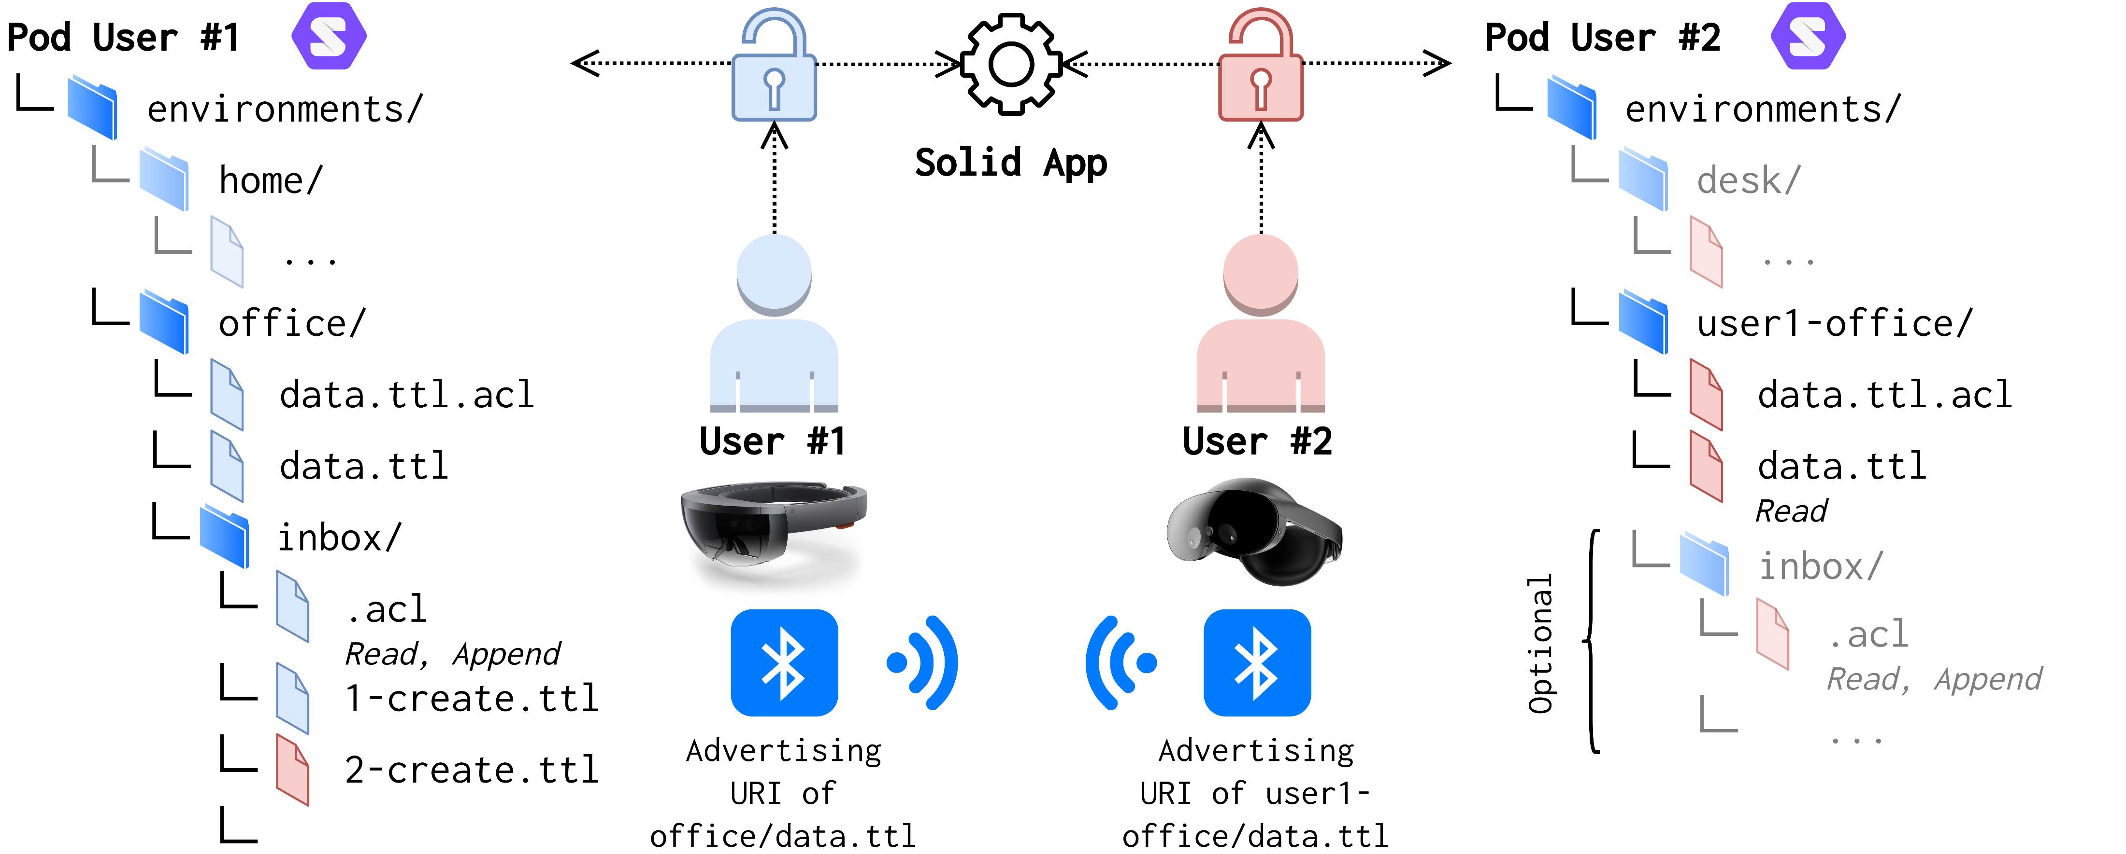
Solid Symposium 2 - 3 May, 2024

Slide 22
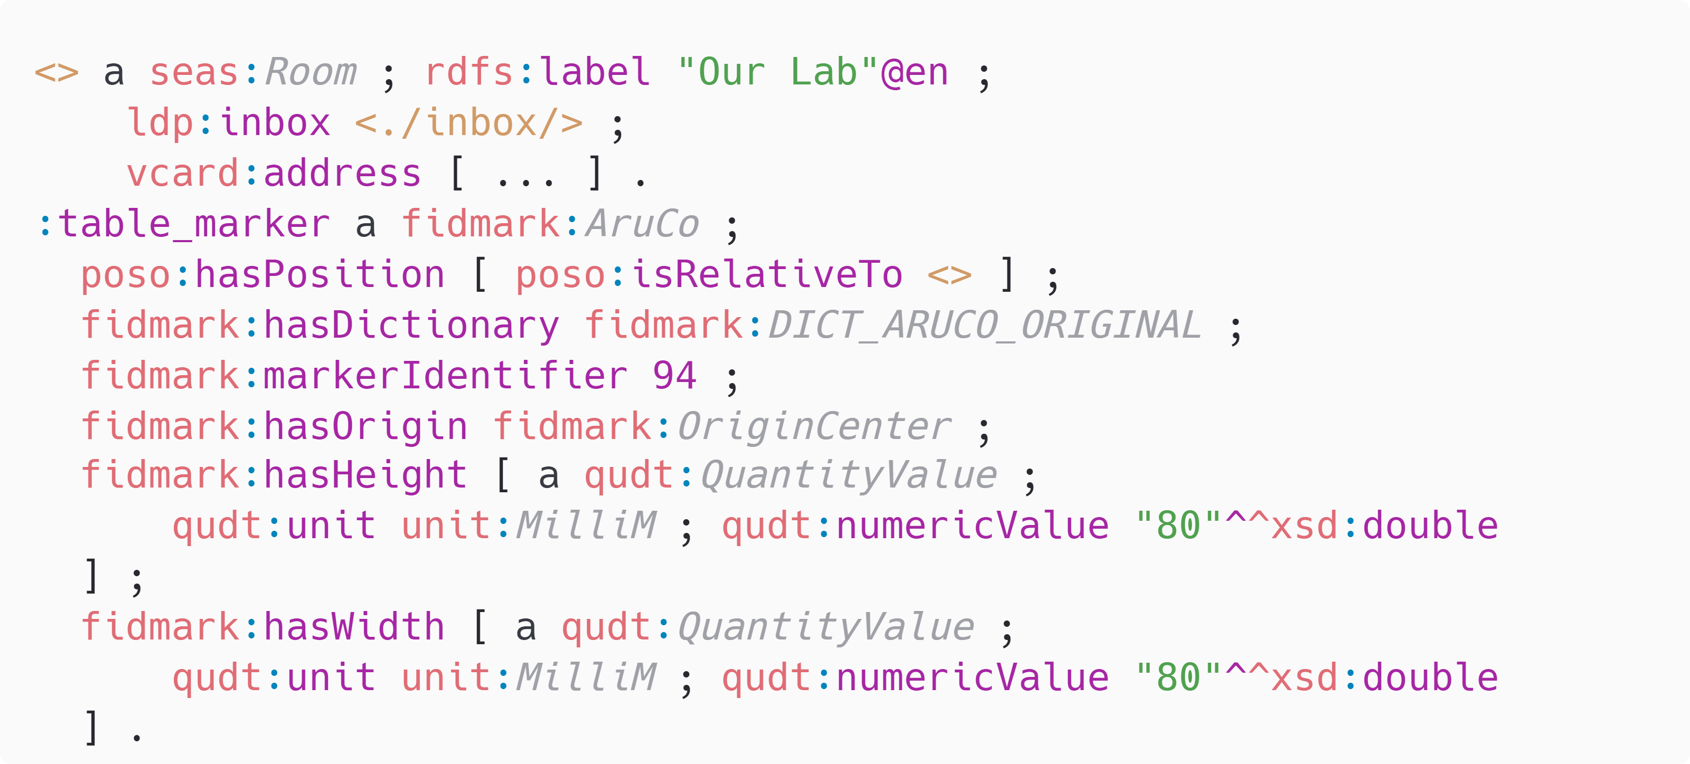
Solid Symposium 2 - 3 May, 2024

